Slide 1
Biomimetic Fish
The Aquamen
Abdulrahman Alnebari
Shuaib Alshuaib
James Brooks
Nathan Servis
Background Presentation

Slide 2
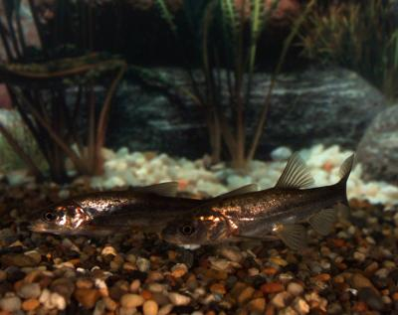
Our Client: Dr. Alice C. Gibb
Gibb Lab, NAU, Wettaw Building
Interests are in Morphology and Physiology
Utilize high frame rate cameras to analyze motion in fish
Electromyography to analyze the sequence which muscle cells activate
Fig 1: Round Tail Chub - Gibb Lab
James Brooks

Slide 3
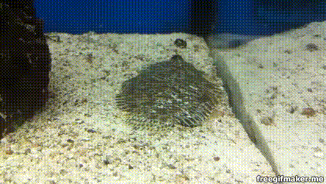
Background
Fish oscillate their bodies to force water into sand to bury themselves.
Build Test Equipment which can mimic the reactions needed to force water into sand-- a process called fluidization.
Adapt Test Equipment data into a remote-controlled biomimetic robotic-fish
Mechanisms which induce fluidization of substrate can be applied to:
Self-Burying Drones
Boat Anchors
Biomimetic Robotic-Fish
Test Equipment Goals:
Best shapes for rapid burial
Which substrates are too heavy for body size
Fig 2 Flounder burying itself in sand [1]
James Brooks

Slide 4
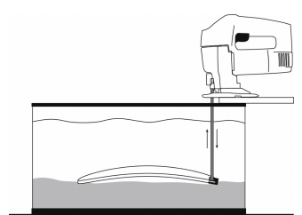
Project Description
Stage 1 : Build Test Fixture
Measure amplitude and frequency of oscillations
Modular components to switch test parameters
High Visibility of Test Specimen
Fig 4: Undulation frequency affects burial performance in living and model flatfishes Amberle McKeea, Ian MacDonald, Stacy C. Farina, Adam P. Summers [2]
James Brooks

Slide 5
Project Description
Stage 2: Build Biomimetic Fish Prototype
Self-burying functionality
Controller to send signals
Computer to receive signals
Power Supply for systems
Motors to generate momentum
Mimics Fish
James Brooks

Slide 6
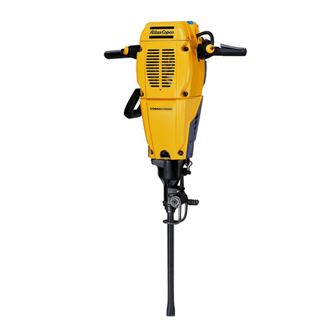
Benchmarking - Wave Generating
Wave Pool
  Generates a wave that propagates small distances
Jack Hammer
  Actuates to break up material
Figure 5 : Jack Hammer [3]
Nathan Servis
Notes:
Wave Pool great at generating waves under water using pressurized air and a device similar to an “accordian”

Slide 7
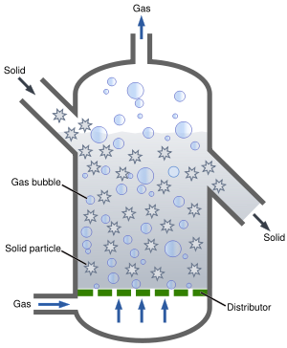
Benchmarking - Fluidization
Fluidization Beds
  Used to separate Materials, as well as use in Chemical reactors
Quick Sand
Figure 6: Fluidization Bed [4]
Nathan Servis

Slide 8
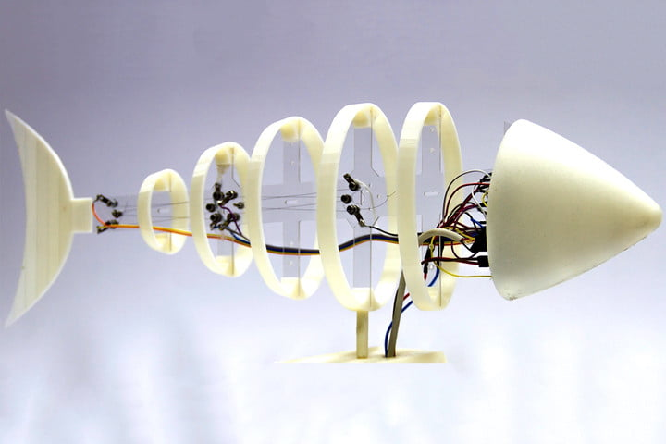
Background - Robotics
Cartesian Coordinate Robot
  Device that moves in x and y coordinates (I.e. CNC and 3D printer)
Fish Robot
  Autonomous fish that travels the oceans examining ph levels
Figure 7 : Robotic fish, from the university of spain [5]
Nathan Servis

Slide 9
Customer Requirements (CR)
Actuator
Test subjects with different sizes & shapes
Generate different oscillations
electronically controlled
Robotic Fish
Depth (1 ft)
Buries itself
Convert substrate into fluid
Biomimetic
Remote controlled
Water resistant
Varied amplitude & frequency
Durability
Reliability
Shuiab Alshuaib

Slide 10
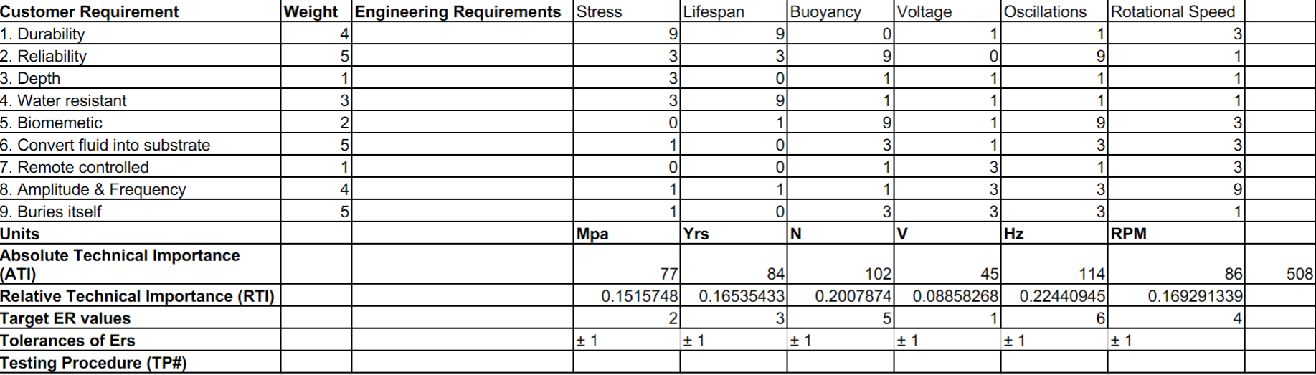
Engineering Requirements (ER) and QFD
Stress (MPa)
Lifespan (Years)
Voltage (V)
Buoyancy (N)
Oscillations (Hz)
Rotational Speed (rpm)
Table 1: QFD
Shuiab Alshuaib

Slide 11
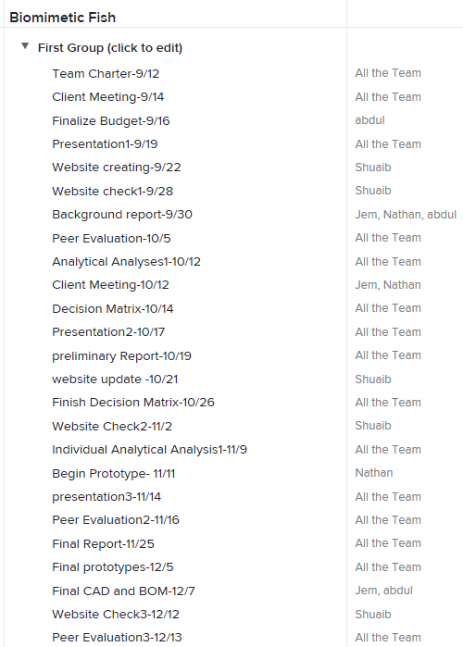
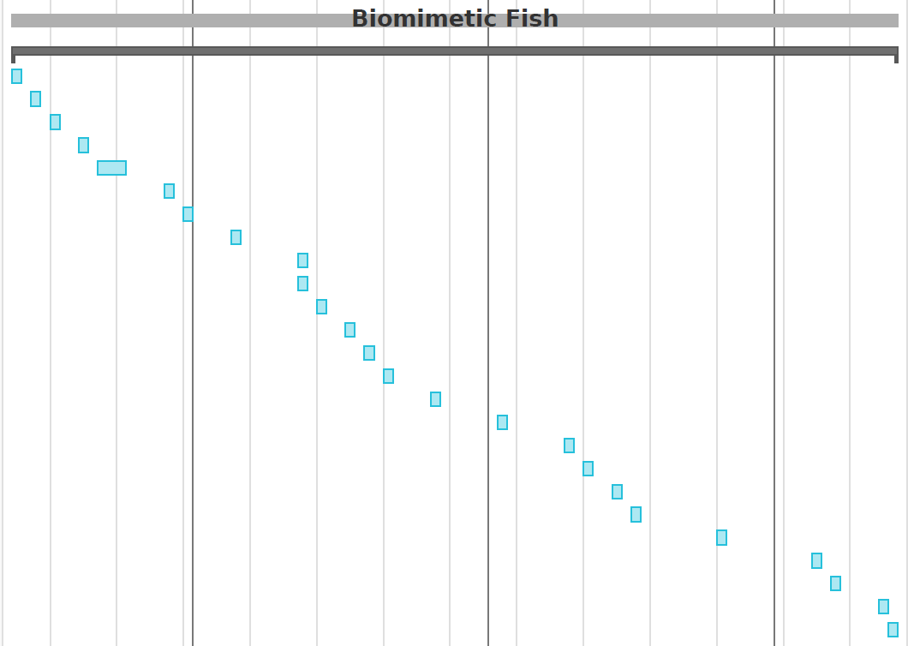
Gantt Chart
Abdulrahman Alnebari

Slide 12
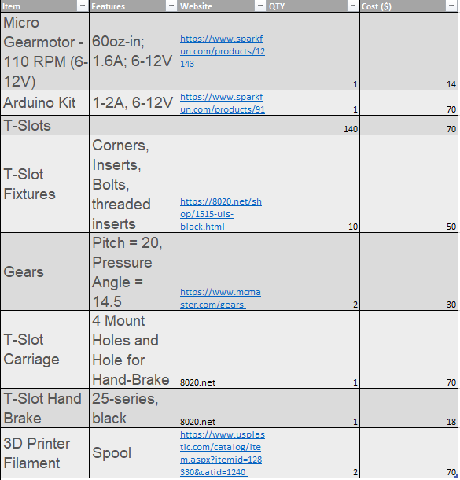
Budget
The team has estimated the budget to be about $400
Table 2: Mock Budget
Abdulrahman Alnebari

Slide 13
References
A. Mckee, I. Macdonald, S. C. Farina, and A. P. Summers, “Undulation frequency affects burial performance in living and model flatfishes,” Zoology, vol. 119, no. 2, pp. 75–80, 2016.
Richmondreefer, YouTube, 05-Jun-2012. [Online]. Available: https://www.youtube.com/watch?v=0HDH9pox1j4. [Accessed: 19-Sep-2018].
Multiweb Pty Ltd, “PETROL JACKHAMMER #505755 | DEMOLITION > HAMMER > TOOLS HIRE EXPRESS,” Hire Express. [Online]. Available: https://www.hireexpress.com.au/product.view&pid=1801. [Accessed: 19-Sep-2018].
“Fluidized bed reactor,” Wikipedia, 26-Jan-2018. [Online]. Available: https://en.wikipedia.org/wiki/Fluidized_bed_reactor#/media/File:Fluidized_Bed_Reactor_Graphic.svg. [Accessed: 19-Sep-2018].
L. Dormehl, “This robotic fish patrols the ocean, gathering water quality info as it swims,” Digital Trends, 17-May-2017. [Online]. Available: https://www.digitaltrends.com/cool-tech/fish-robot-senses-water-quality/. [Accessed: 19-Sep-2018].

